Slide 1

CREDENTIALS 2026
Good ideas.
Very real.
Notes:
Evenflow connects the idea to the experience. Open by asking what the client needs their audience to think, feel or do. Then explain that our range includes events, environments, films and technology. Cover images: The Leela experience centre and the Guidewire live performance. For Guidewire, Evenflow designed and Skunkworks executed the work.
Sources
Source: Credentials 2025(1).pdf, supplied by Evenflow. Page 69.
https://www.behance.net/gallery/226540351/Gudiewire-Live-InteractivePerformance
Original Evenflow logo supplied by the client.

Slide 2
OUR STARTING POINT
Your audience
has better
things to do.
We make showing up worth it.
Would we want to be there? That question survives every brief.
02
Notes:
Our creative test is simple: would we want to experience this as an audience? Explain that respecting attention means understanding who is coming, why they are there and what the business needs from the experience. The humour is a way into a serious point about audience value.
Sources
Source: Vipul Ganatra’s supplied philosophy and project brief.

Slide 3
evenflow EXPERIENCES
The ideas refused
to stay in one lane
Events
Conferences, launches, celebrations and live shows.
Spaces
Exhibition stands, experience centres and interiors.
Films & motion
Screen content, brand films and visual storytelling.
Technology
Interactive ideas, immersive media and digital experiences.
03
Notes:
We began in events and expanded into design, films and technology. The same client understanding runs through every discipline. Introduce only the disciplines relevant to this pitch in detail. We select specialists and execution partners to suit the work.
Sources
Source: Vipul’s supplied agency introduction. Source: Credentials 2025(1).pdf, supplied by Evenflow. Pages 2–5, 12–136. Source: evenflow Stalls & Interiors (1).pdf, supplied by Evenflow.

Slide 4
SELECTED PROJECT EXPERIENCE
Some familiar names.
Some very different briefs.
Accenture
AB InBev
PwC
SAP
GE
Wipro
Fidelity
Guidewire
The Leela
GROHE
EO
Ola
Google
Nike
Estée Lauder
SpotDraft
Selected work across events, environments and design collaborations.
04
Notes:
These names represent selected projects in the supplied portfolio and client-confirmed design collaborations. They do not imply endorsements or current retainers. Some brand environments appear within another client’s campus or programme. We credit specialist execution partners on the relevant case slides.
Sources
Source: Credentials 2025(1).pdf, supplied by Evenflow. Page 6 and project pages. Source: evenflow Stalls & Interiors (1).pdf, supplied by Evenflow. Google, GE and Ola sections.
Client-confirmed project ownership: https://www.behance.net/gallery/226540351/Gudiewire-Live-InteractivePerformance
https://www.behance.net/gallery/239239341/SKUNKWORKS-X-ABInBev
https://www.behance.net/gallery/238861837/SKUNKWORKS-X-ACCENTURE
https://www.behance.net/gallery/227017511/Skunkworks-X-Este-Lauder-Companies
https://www.behance.net/gallery/230760635/Skunkworks-X-SpotDraft

Slide 5
BEFORE THE BIG IDEA
The business
behind the brief
What needs to change?
Belief, understanding, demand or belonging.
Who needs to care?
Their context, expectations and reasons to act.
What will make it work?
The format, message and experience they need.
“Make it pop” is a comment.
We’ll still need the brief.
What can we commit to?
Budget, timing, approvals and practical constraints.
05
Notes:
Use this slide to turn the pitch into a conversation. Ask for the commercial or organisational purpose before discussing creative formats. These are the questions we propose to align on for the new engagement, rather than a claim that any past project achieved a particular business result.
Sources
Source: Client’s stated emphasis on understanding the client and clarity of purpose.

Slide 6
EO / RIEMIX 2025
A community.
At full volume.
An event identity that
carried through the stage,
the welcome and the
things people took home.
Live event and experience design
06
Notes:
The EO RIEMIX portfolio shows a cohesive event identity across welcome experiences, wayfinding, bags, stage design and entertainment. Focus on the repeated visual language and how the experience extends beyond the stage. Avoid assigning attendance or satisfaction metrics not documented in the source.
Sources
Source: Credentials 2025(1).pdf, supplied by Evenflow. Pages 13–20. Photograph from page 15.

Slide 7
AB INBEV / ANNUAL DAY 2023
A big night needs
a bigger sense of occasion
2,000
employees
Sheraton Grand
Whitefield, Bengaluru
Employee celebration
07
Notes:
The credentials record an Annual Day for 2,000 AB InBev employees at Sheraton Grand Whitefield in 2023. Talk about the scale and the visible stage and lighting treatment. The attendance figure is a source-backed scope metric, not a claim about effectiveness or return on investment.
Sources
Source: Credentials 2025(1).pdf, supplied by Evenflow. Page 22.

Slide 8
GUIDEWIRE / DEV SUMMIT 2025
Technology,
with a pulse
Live performance and screen
worlds built around the
same moment.
Design: evenflow Experiences. Execution: Skunkworks Studio.
08
Notes:
The Guidewire DEV Summit 2025 work combines performance with large screen environments. Use the image to explain coordination between visual content and the live experience. Evenflow designed the work and outsourced execution to Skunkworks Studio, as confirmed by Vipul. The cover features a second image from this project.
Sources
https://www.behance.net/gallery/226540351/Gudiewire-Live-InteractivePerformance
Client confirmation of design ownership and execution partner in the conversation.

Slide 9
SAP / STARTUP SOCIAL
The garage had a guest list
A garage theme gave the launch a setting rooted in startup culture.
09
Notes:
SAP Startup Social’s launch used a garage theme. The set built the idea into the environment through workshop objects and a casual gathering space. This example shows how a recognisable setting can express the purpose of an event without relying entirely on messaging on a screen.
Sources
Source: Credentials 2025(1).pdf, supplied by Evenflow. Page 27.

Slide 10
THE LEELA / EXPERIENCE CENTRE
A brand you
can walk into
An experience centre in
Indiranagar, Bengaluru.
Architectural detail and material
choices carry the hospitality story.
Experience design and space design
10
Notes:
The Leela experience centre offers a different expression of the same agency: hospitality, detail and restraint. Discuss the visible arched forms, timber treatment, lighting and seating as design decisions. The portfolio names the location as Indiranagar. Avoid claiming commercial outcomes or describing a hotel property that is not identified in the source.
Sources
Source: Credentials 2025(1).pdf, supplied by Evenflow. Page 69.

Slide 11
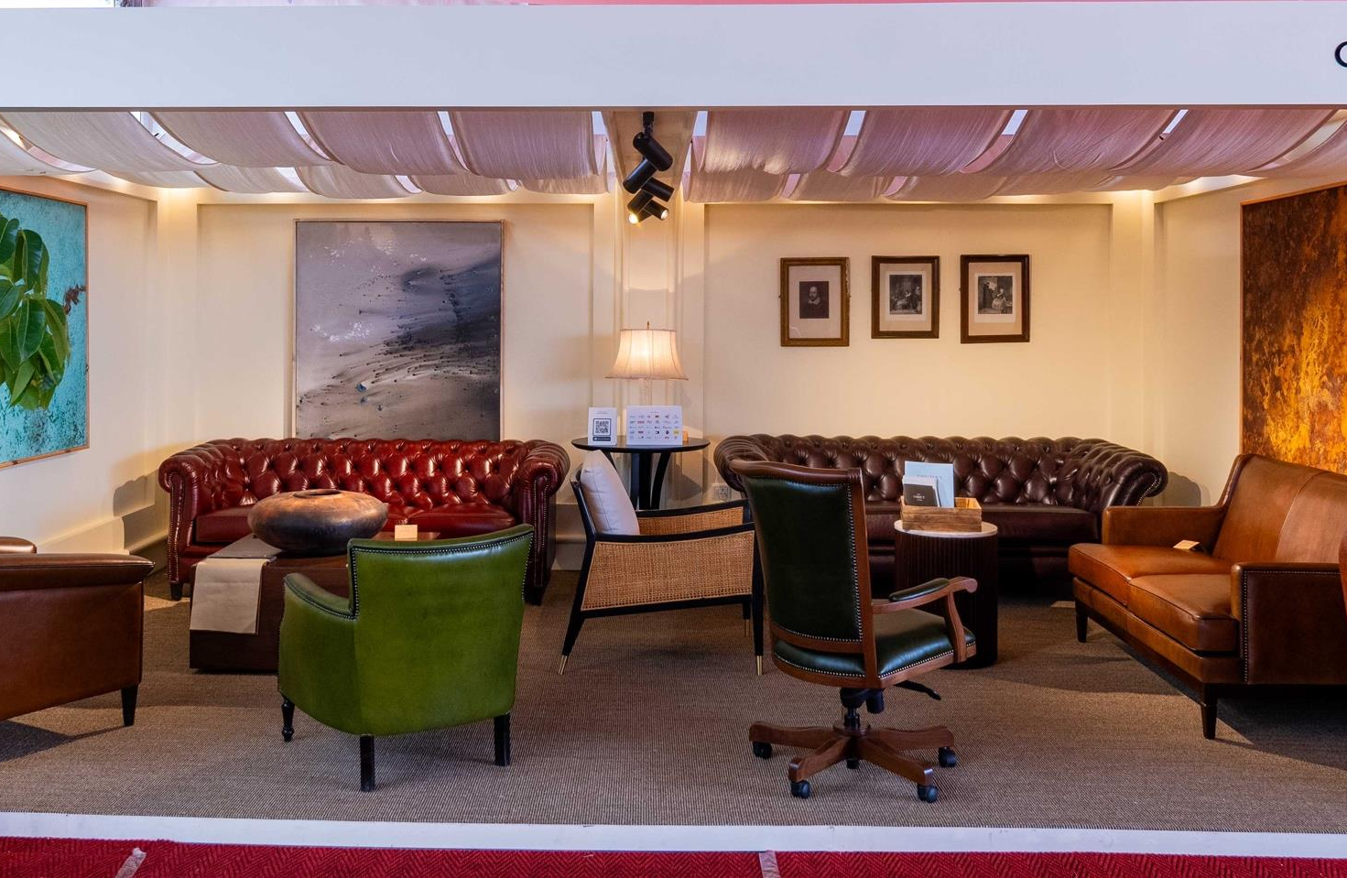
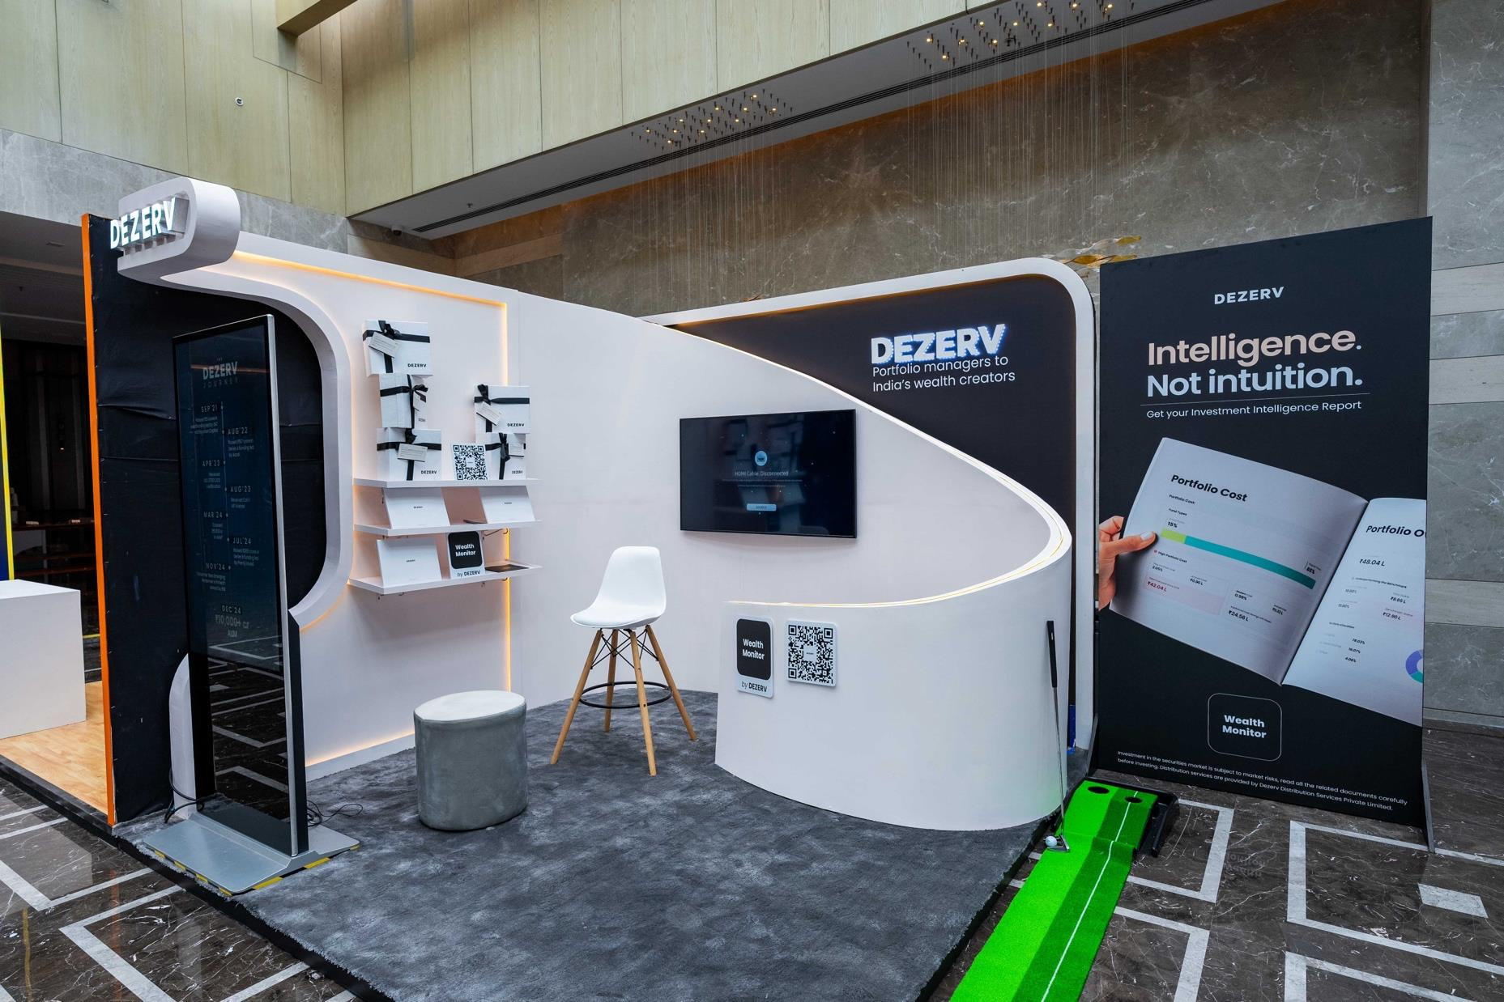
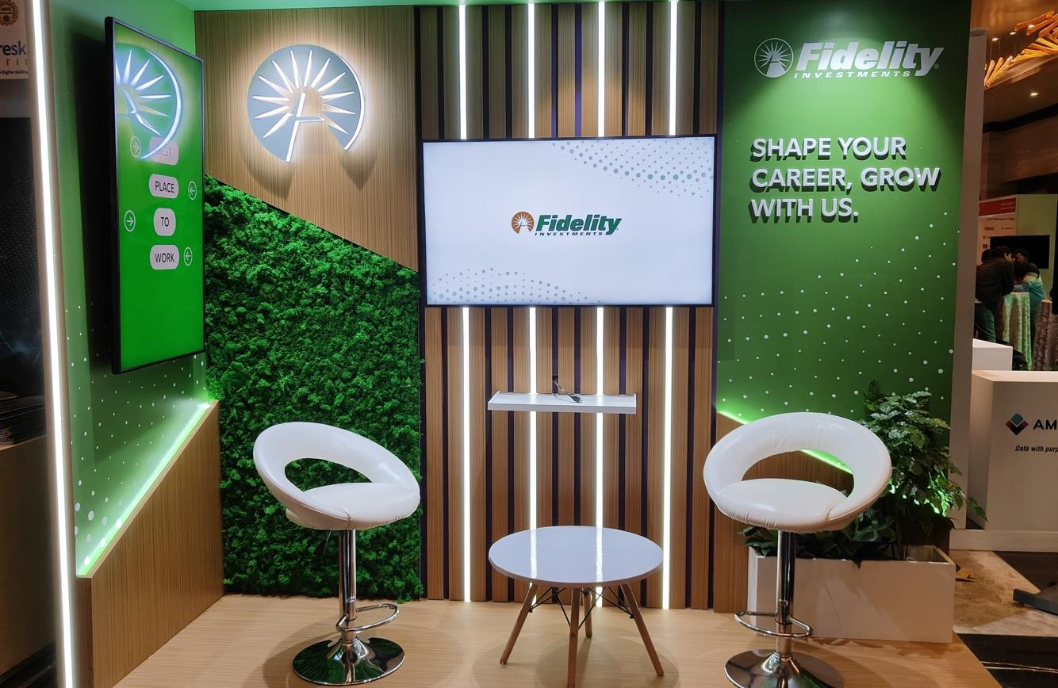
EXHIBITION STANDS
A few square metres.
A whole brand.
Chester’s
DESERV
Fidelity
EO RIE 2025
EO RIE 2025
NASSCOM 2025
11
Notes:
These three photographed exhibition spaces show different brand treatments: a hospitality setting for Chester’s, a product-focused environment for DESERV, and a planted, luminous setting for Fidelity. When tailoring a pitch, discuss visitor flow, demonstration needs and conversation space rather than just the structure.
Sources
Source: Credentials 2025(1).pdf, supplied by Evenflow. Pages 62, 63 and 65. Original embedded photographs.

Slide 12
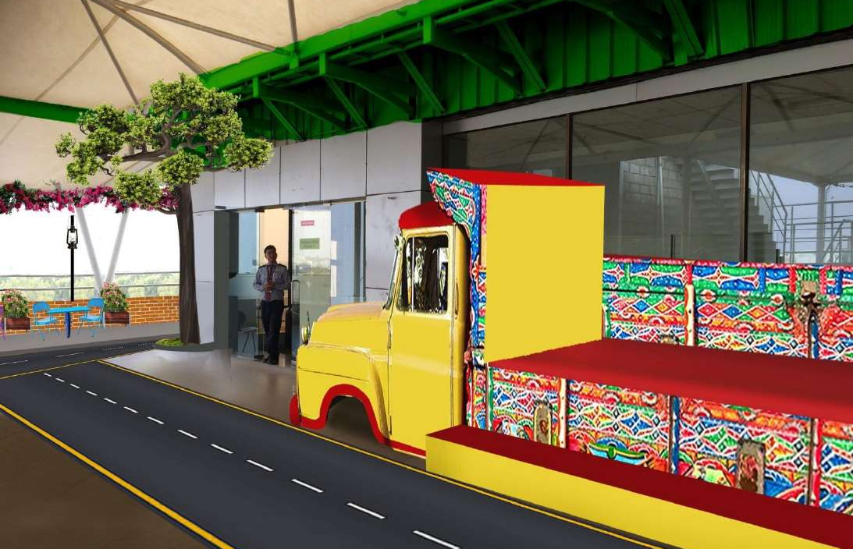
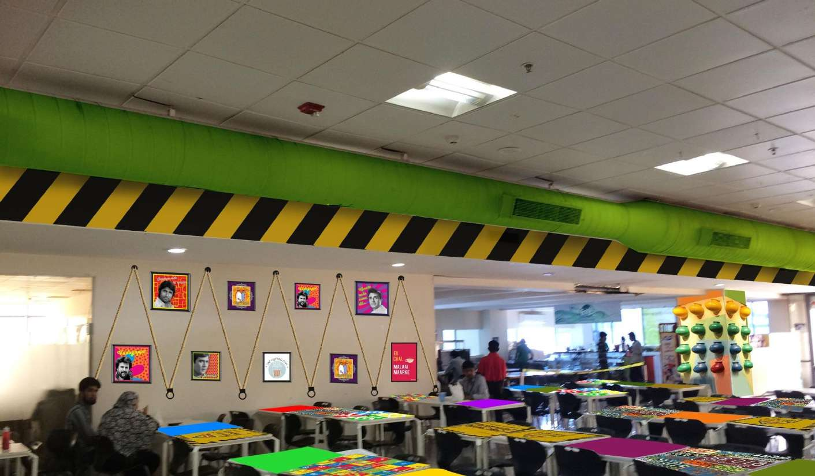
OLA / WORKPLACE INTERIORS
Workplaces can
have a personality
A familiar brand language, carried into shared spaces.
12
Notes:
The supplied interiors portfolio includes photographed Ola workplace spaces. The vehicle-inspired setting and cafeteria treatment connect everyday spaces to the brand’s world. Present these as portfolio photographs. Do not imply a new office completion date or an unverified floor area.
Sources
Source: evenflow Stalls & Interiors (1).pdf, supplied by Evenflow. Pages 142–150, images from pages 148 and 146.

Slide 13
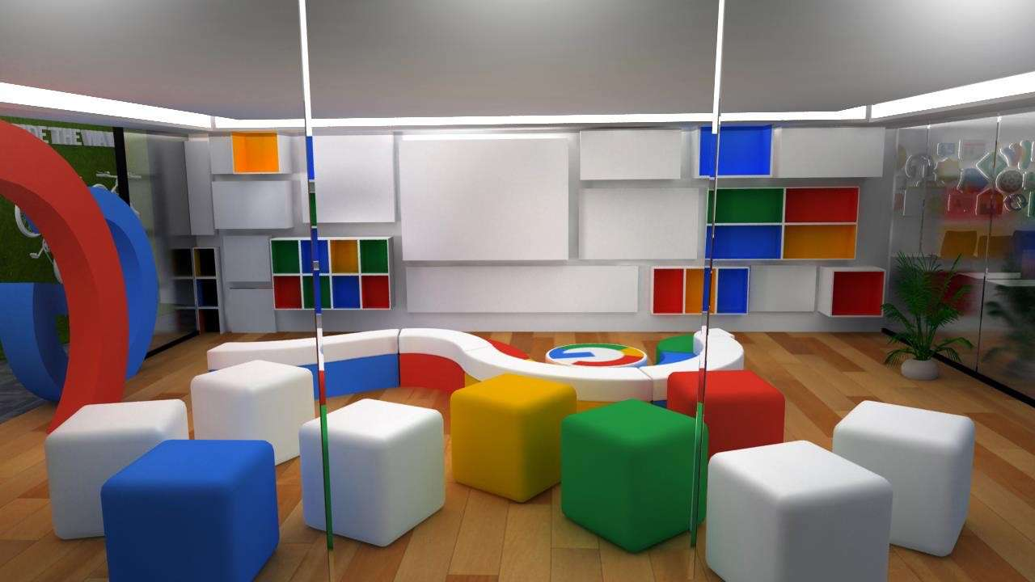
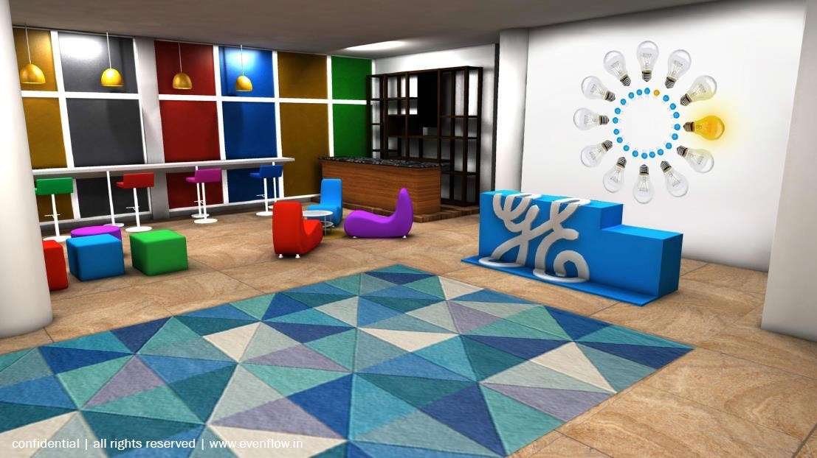
INTERIOR DESIGN STUDIES / RENDERS
Before anyone builds,
everyone can see it
Google / Workplace concept
GE / Reception concept
13
Notes:
These are design renders from the supplied stalls and interiors portfolio, not photographs of completed installations. They show how we use visualisation to make brand, material, lighting and spatial choices concrete before fabrication. Keep that distinction explicit in a pitch.
Sources
Source: evenflow Stalls & Interiors (1).pdf, supplied by Evenflow. Google interiors, page 60. GE reception, page 80.

Slide 14
Estée Lauder Companies
The room becomes the story
Immersive brand environment / design visualisation
Design: evenflow Experiences. Execution: Skunkworks Studio.
Notes:
This design visualisation shows a surrounding brand environment for Estée Lauder Companies. Discuss how screen content, multiple brand identities and architecture occupy the same space. The visual is a render. Evenflow designed the work and Skunkworks executed it, according to the client’s ownership clarification.
Sources
https://www.behance.net/gallery/227017511/Skunkworks-X-Este-Lauder-Companies
Client confirmation of design ownership and execution partner.

Slide 15
AB INBEV / SCREEN WORLDS
A screen can do more
than hold a logo
Cinematic content / motion visual
Design: evenflow Experiences. Execution: Skunkworks Studio.
Notes:
The frame shows cinematic motion content developed for the AB InBev portfolio. It is a motion visual, not a photograph of a finished stage. Present the work as an example of building scale, atmosphere and a sense of spectacle through content. Avoid claims about audience impact that were not measured.
Sources
https://www.behance.net/gallery/239239341/SKUNKWORKS-X-ABInBev
Client confirmation: Evenflow design, Skunkworks execution.

Slide 16
ACCENTURE / MOTION DESIGN
A visual language
that keeps moving
A consistent treatment across screen content and transitions.
Design: evenflow Experiences. Execution: Skunkworks Studio.
16
Notes:
The supplied Accenture motion project shows a coherent visual treatment across multiple frames and transitions. Use it to discuss consistency across a full event content package. Keep the conversation focused on motion design and consistency across the content package.
Sources
https://www.behance.net/gallery/238861837/SKUNKWORKS-X-ACCENTURE
Client confirmation: Evenflow design, Skunkworks execution.

Slide 17
NIKE / INTERACTIVE INSTALLATION CONCEPTS
An invitation
to play
Projection, digital surfaces and
objects with a little more ambition.
Design renders
17
Notes:
These Nike installation proposals come from the design section of the original credentials. They are concept renders, not evidence of a completed activation. Talk about the proposed use of projection mapping, digital content and physical form to make the brand an active experience.
Sources
Source: Credentials 2025(1).pdf, supplied by Evenflow. Pages 112–116.

Slide 18
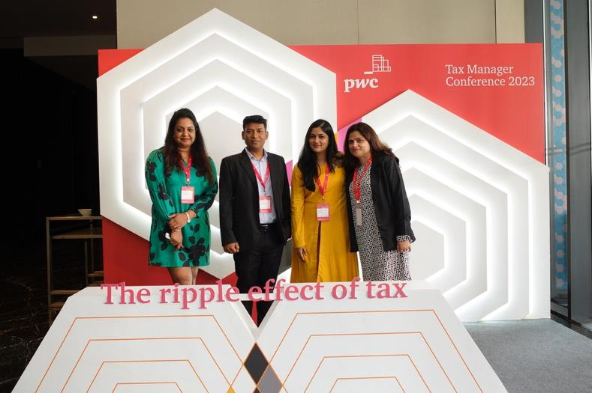
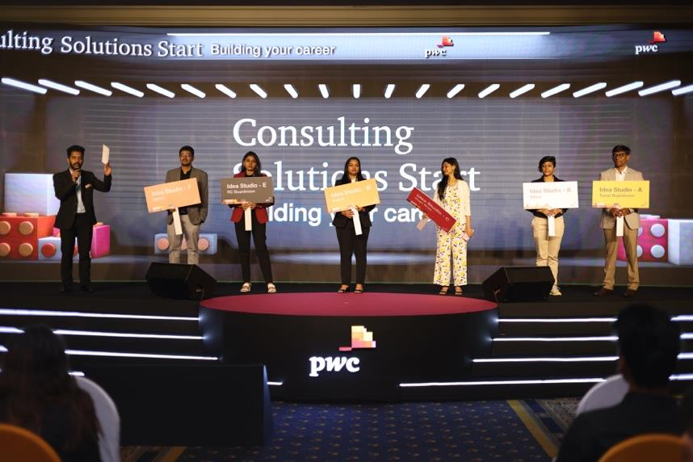
PWC / CONFERENCES AND INDUCTION
Business on the agenda
3-day conference
5-day freshers’ induction
Hilton
The Leela Palace
Notes:
These two documented PwC programmes demonstrate our work beyond entertainment-led events: a three-day conference at Hilton and a five-day induction programme at The Leela Palace. Use the duration as a programme scope fact. Ask about session design, content approvals and delegate experience for the client’s own programme.
Sources
Source: Credentials 2025(1).pdf, supplied by Evenflow. Pages 23 and 25.

Slide 19
HOW WE WORK
The backstage bit matters
Client understanding
Creative development
A clear brief, named decision-makers
and an agreed scope.
A concept with a reason to exist,
made tangible through design.
Production planning
Delivery
Budget, suppliers, technical needs
and a schedule people can use.
Clear responsibilities, rehearsals
and decisions made in time.
19
Notes:
Walk through the operating model proposed for the engagement. The agency’s credentials describe creative, operations and client servicing teams. Explain how these roles join up around the client brief, budget and production schedule. Agree specific owners, approval dates and scope in the project plan rather than promising an unqualified turnaround.
Sources
Source: Credentials 2025(1).pdf, supplied by Evenflow. Page 4. Client philosophy: good work quickly, agility and responsiveness.

Slide 20
WHAT SUCCESS LOOKS LIKE
We agree success
before the doors open
For a launch
For an internal event
What should people understand,
try or enquire about?
What should colleagues know,
feel or do differently?
For a space
For every brief
How should visitors move,
explore and start conversations?
Which evidence will show
whether it worked?
20
Notes:
This slide describes how we propose to define success with a client. Agree the measures at the start of each engagement. Depending on the brief, agree suitable measures such as attendance, qualified conversations, product trials, content comprehension, colleague feedback or useful follow-up. Ensure data collection, ownership and reporting responsibilities are agreed in scope.
Sources
Source: New pitch methodology based on the client’s stated business-understanding objective.

Slide 21
THE evenflow PHILOSOPHY
Done well.
Done quick.
We take the work seriously.
Ourselves, a little less.
21
Notes:
Bring the conversation back to the core philosophy Vipul supplied: the work has to be done, done well and done quickly. This is an attitude to the brief, not a blanket service-level guarantee. Explain how clarity and timely decisions help us move without losing the quality of the idea.
Sources
Source: Vipul Ganatra’s original Evenflow purpose and philosophy, supplied in the conversation.

Slide 22
What are
we making?
A brief. A problem. A very ambitious idea.
Prithvi
Explore the work
prithvi@evenflow.in
Watch the showreel
+91 95915 07929
Notes:
Close by asking for the client’s business objective, intended audience, date and budget range. New project enquiries go to Prithvi. The website and showreel links need an internet connection. All project imagery in the deck remains available offline.
Sources
Source: Contact details supplied by Vipul: prithvi@evenflow.in and 9591507929.

